Slide 1
C S Mini Project
Currently go through the programs and make notes in this ppt under the topic names.
Snake and Tic tac toe, also check if hangman works, if it does and we have time to study things related to it, we’ll put that up in the synopsis sheet.
This color is just for info
This color is the info related to the project.

Slide 2
Snake Game
#include<time.h>
It describes three time related datatypes.
clock_t: clock_t represents the date as integer which is a part of the calendar time.
time_t: time_t represents the clock time as integer which is a part of the calendar time.
struct tm: struct tm holds the date and time which contains:
struct tm
{ int tm_sec; // seconds, range 0 to 59
int tm_min; // minutes, range 0 to 59
int tm_hour; // hours, range 0 to 23
int tm_mday; // day of the month, range 1 to 31
int tm_mon; // month, range 0 to 11
int tm_year; // The number of years since 1900
int tm_wday; // day of the week, range 0 to 6
int tm_yday; // day in the year, range 0 to 365
int tm_isdst; // daylight saving time
}
(d) It also contains CLOCKS_PER_SEC macro which holds the number of times does the system clock ticks per second.
ctime() : This function returns the date and time in the format day month hours:minutes:seconds year Eg: Sat Jul 27 11:26:03 2019 time is printed based on the pointer returned by Calendar Time.

Slide 3
2. #include<conio.h>
conio.h is a header file mostly used by MS-DOS compilers to provide console input and output. Some of its inbuilt functions are:
(a) clrscr() - It is used to clear the screen
(b) cgets() - Reads a string from the keyboard
(c) getch() - Reads a character from keyboard
(d) getche() - Reads a character
(e) kbhit() - Determines if a keyboard key was pressed
(f) putch() - Writes a character to the screen
(g) cputs() - Writes a string to the screen
3. #include<ctype.h>
toupper() : This function convert lowercase alphabet to uppercase alphabet.
4. #include<windows.h>
It has a structure called COORD.
typedef struct _COORD
{
SHORT X;
SHORT Y;
} COORD, *PCOORD;
Defines the coordinates of a character cell in a console screen buffer. The origin of the coordinate system (0,0) is at the top, left cell of the buffer.

Slide 4
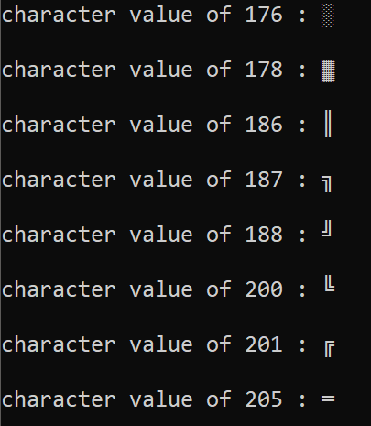
"GetStdHandle(STD_OUTPUT_HANDLE), coord)"
Basically, it gets a handle you can use to write to the console. SetConsoleCursorPosition then uses that handle and the coordinates you specified to place the blinking cursor in your command prompt.

Slide 5
Tic Tac Toe :)
#include<stdlib.h>
“<stdlib. h>” contains header information for 'Memory Allocation/Freeing' functions; has four variable types, several macros, and various functions for performing general functions.
size_t: This is the unsigned integral type and is the result of the sizeof keyword.
wchar_t: This is an integer type of the size of a wide character constant.
div_t: This is the structure returned by the div function.
ldiv_t: This is the structure returned by the ldiv function.
2. system(cls)
It’s used to clear the screen and the next output is displayed, if any!
THAT’S IT I GUESS HERE. EVERYTHING ELSE IN TTT IS WHAT WE LEARNT :)

Slide 6
HANGMAN
getc():
It reads a single character from a given input stream and returns the corresponding integer value (typically ASCII value of read character) on success. It returns EOF on failure.
getchar():
The difference between getc() and getchar() is getc() can read from any input stream, but getchar() reads from standard input. So getchar() is equivalent to getc(stdin).
getch():
getch() is a nonstandard function and is present in conio.h header file which is mostly used by MS-DOS compilers like Turbo C. It is not part of the C standard library or ISO C, nor is it defined by POSIX (Source: http://en.wikipedia.org/wiki/Conio.h)
Like above functions, it reads also a single character from keyboard. But it does not use any buffer, so the entered character is immediately returned without waiting for the enter key.
getche()
Like getch(), this is also a non-standard function present in conio.h. It reads a single character from the keyboard and displays immediately on output screen without waiting for enter key.

Slide 7
#include<stdlib.h>
The stdlib.h header defines four variable types, several macros, and various functions for performing general function

